Slide 1
Transcriptomic Data Analysis
Muhammad Arif

Slide 2

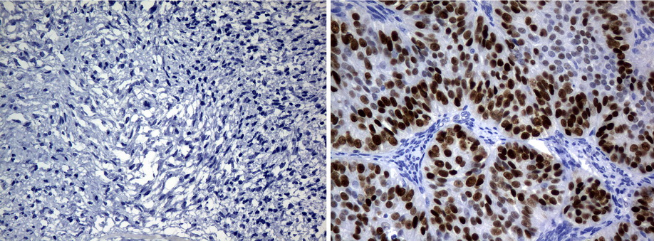


Motivations
Understand the characteristic of tissues and cells
Identify the effect of perturbations or variation due to phenotypical differences:
Genes
Functions
Metabolism
etc
Lean vs Obese
Normal vs Cancer
Healthy vs Disease

Slide 3
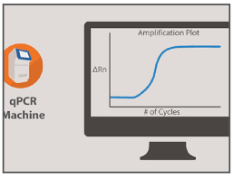
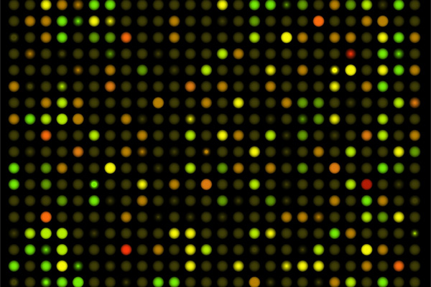
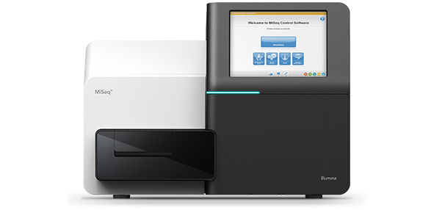
Introduction
Study of human transcriptome:
RNA transcript
Under specific conditions
Methods:
qPCR
Microarrays
RNA-Seq
Goal: quantifying expressions from >200K transcripts and >20K genes

Slide 4
Why RNA-Seq?
qPCR is not scalable, only suitable for handful number of genes
MicroArray can give higher number of genes, but:
Limited dynamic range
Probe must be design correctly (by prior knowledge)
RNA-Seq is the most comprehensive and advanced technology to extract information from RNA
Cheaper and Faster
Better detection of low expression, alternative splicing and other transcriptomic complexity
No prior knowledge required in the design

Slide 5
Transcriptomics Analysis Workflow
Wet-lab Experiments
Quality Control
Genome Mapping
Quantification
RNA Extraction
Library Preparation
Sample Exploration
Differential Expression
Sequencing
Functional Analysis
GEM
Network Analysis
Data Processing
KEGG
GO
FBA
Reporter
Metabolites
Coexp
IN
TRN
Data Analysis

Slide 6
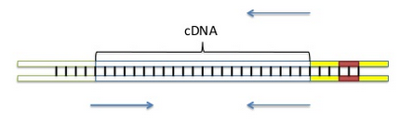
Experiment Design
Long- vs Short-Read:
Longer read provides:
Better assembly capabilities
Higher accuracy in complex regions
Is longer read always better?
More expensive
Depending on your analysis requirement
For standard differential expression analysis, almost no difference
Single- vs Paired-End:
Single: only one end of cDNA fragment generated.
Paired: cDNA fragment is generated from both ends

Slide 7

FASTQ Files
Raw data from sequencing machine
Standardized format
Text based:
Identifier/Name
Nucleotide sequences
Separator
Quality scores

Slide 8
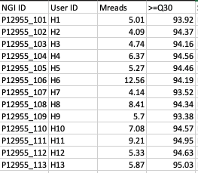
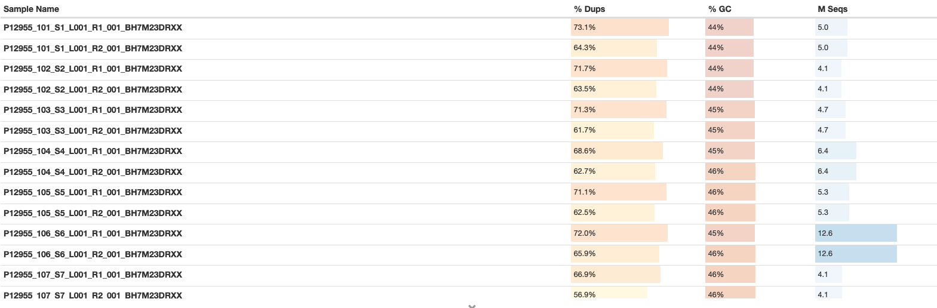
Quality Control
Once we have our raw data, we want to know the quality of the data
Generally, Illumina machines give us their QC result, but there are many other way to do this:
MultiQC
FastQC
During the QC, we can see:
Depth of the sequence
Accuracy
Duplicates
etc
Notes:
fastqc

Slide 9
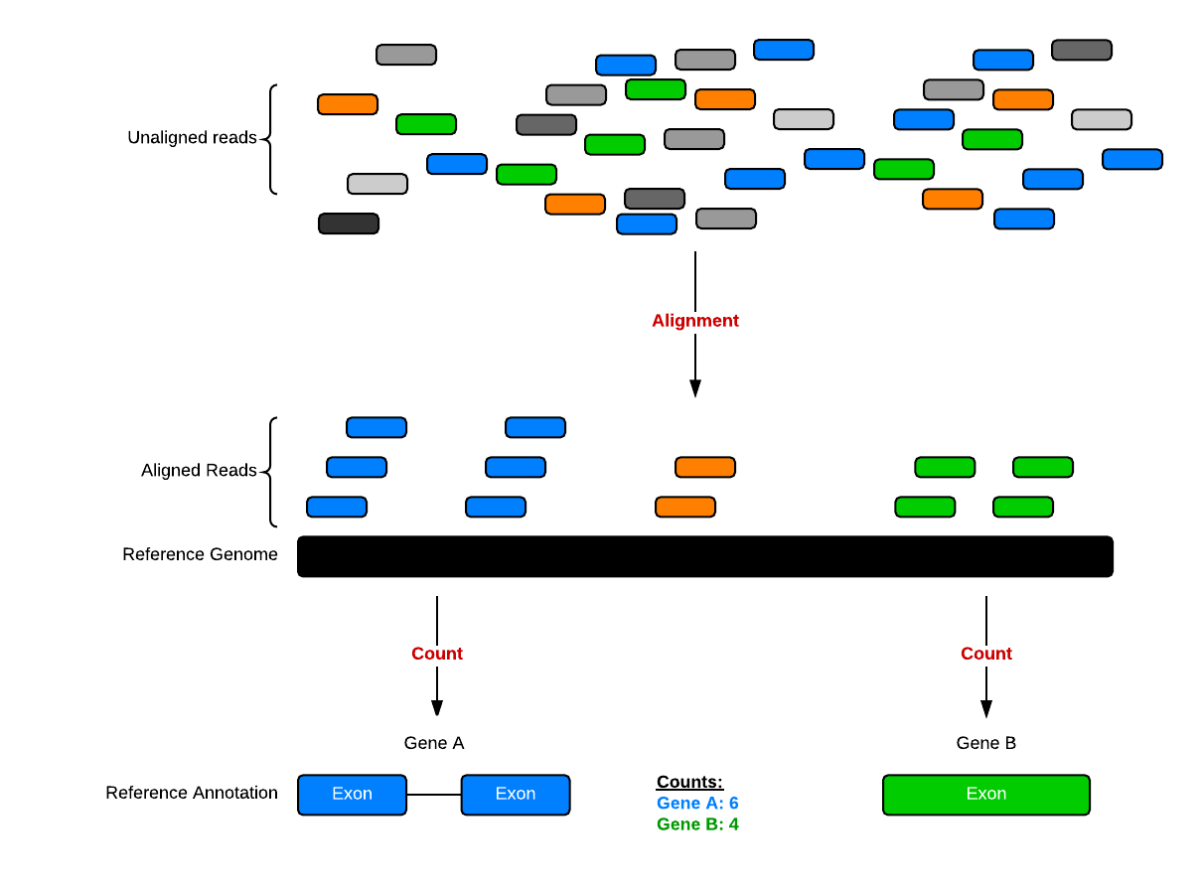
Data Processing (1)
Raw data usually contains fractions of the reads in random way
First, the reads has to be aligned to the correct genome
After the alignment, reads within the same exon are counted
Gene count is the sum of the exons
http://bioconnector.github.io/bims8382/r-rnaseq-airway.html
Notes:
kallisto

Slide 10
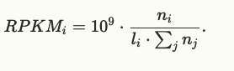
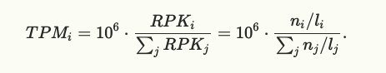
Data Processing (2)
Count
Most of the time, count can be misleading (especially long and short transcript)
Normalization is needed to make it comparable
Method of normalization:
RPKM/FPKM
TPM
CPM
12
Exon 1
Exon 2
Gene A
35
Exon 3
Exon 4
Gene B
Similarity?
Notes:
kallisto

Slide 11
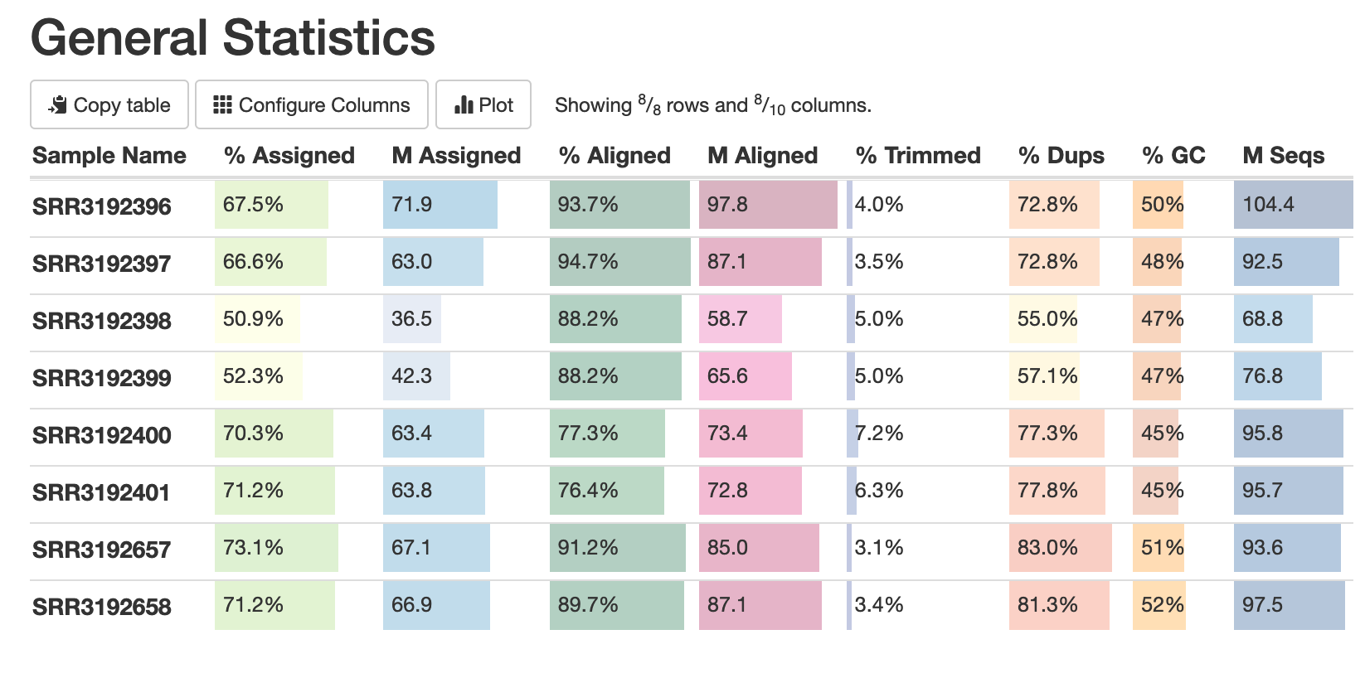
MultiQC

Slide 12
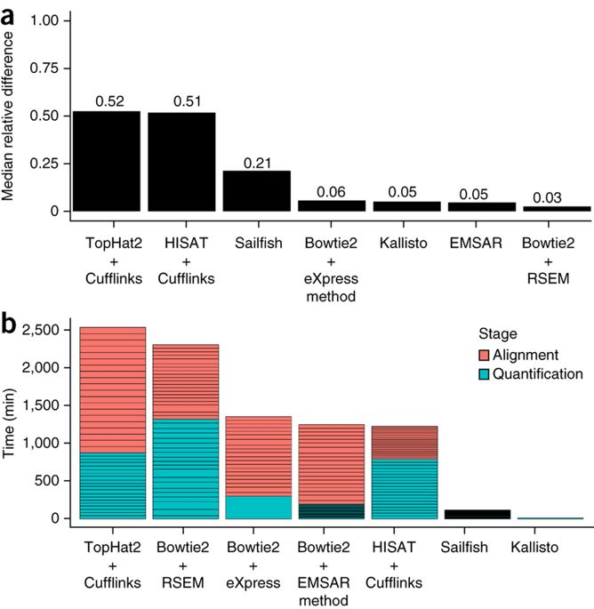
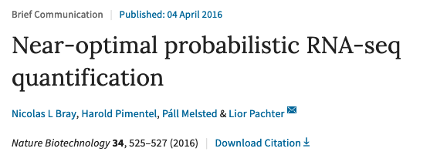
Data Processing (4)
Data Processing from alignment until quantification can be done with many tools:
Kallisto (pseudoalignment)
STAR
Tophat+Cufflink

Slide 13
Data Processing (5)
General Pipeline
Kallisto Pipeline
Library
Library
No nucleotide sequencing
Detecting which transcripts are compatible with the seq
Using Expectation-Maximization algorithm to detect the count
Super fast!
Providing estimated count and TPM
Quality Control
Quality Control
Alignment
Alignment
&
Quantifications
Quantifications

Slide 14

Sample Explorations (1)
After we quantify and normalize the data, we must understand the landscape of the data
Here are some questions that you must ask:
How many samples? Are they all usable?
What are the conditions?
How are the general trend of the sample?
Are they correctly annotated?
Etc
Notes:
Understanding the sampel

Slide 15
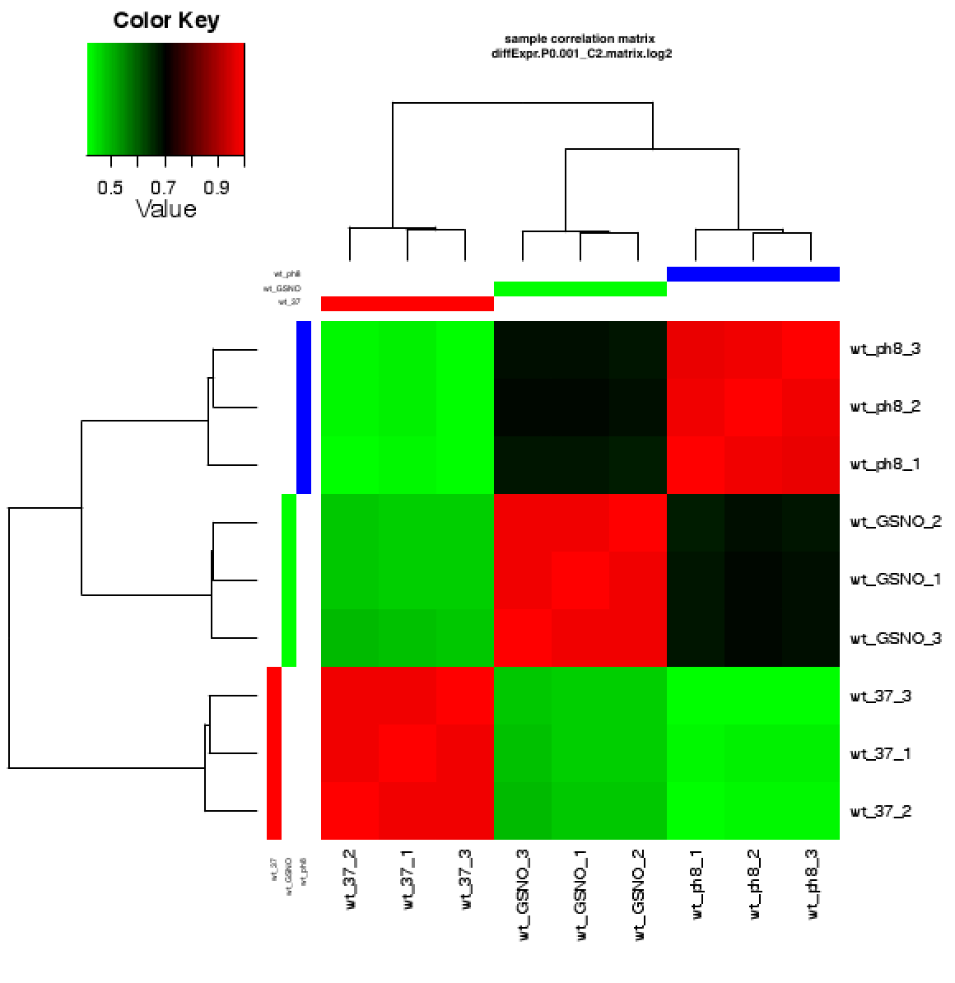
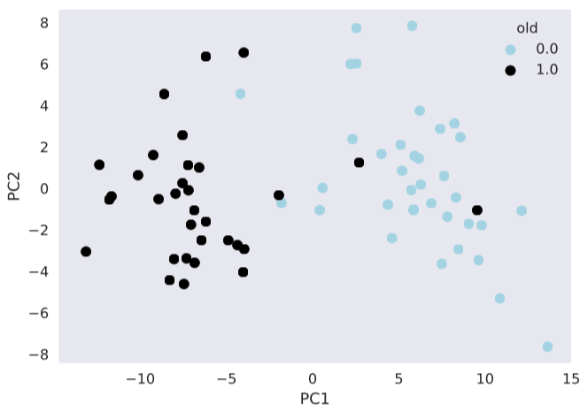
Sample Explorations (2)
Correlation/Clustering Analysis
Dimensionality Reduction (PCA, T-SNE, etc)
Notes:
Understanding the sampel

Slide 16
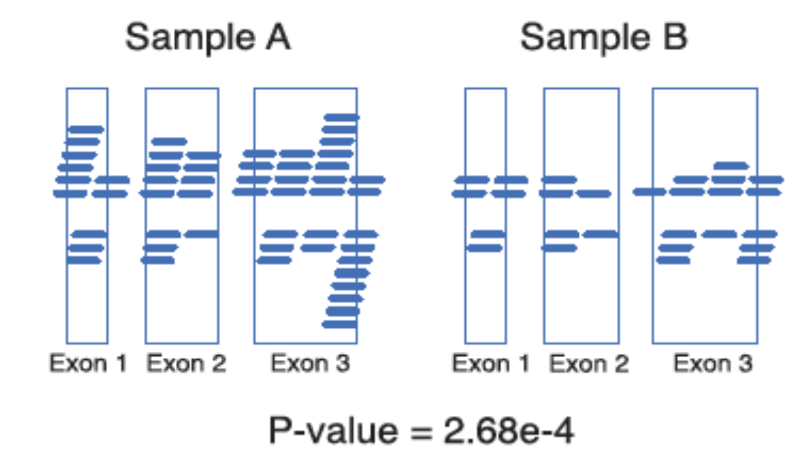
Differential Expression Analysis (1)
To understand the transcriptional changes due to the difference in the phenotype
Observe:
How big is the change?
Over- or under-expressed?
Are they showing real difference?
Approaches:
Standard T-Test
EdgeR
Limma
DeSeq2 → Our favorite!!
Notes:
deseq2

Slide 17
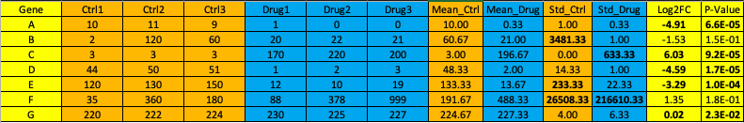
Differential Expression Analysis (2)
Fold-Change: The relative abundance change between conditions
P-Value: Statistical measure to test the null hypothesis (in this case: are they having similar distribution?)
Think about:
When the data has many variables, i.e. 20K genes?
What does it mean when variance/standard deviation is high? Use/Discard?

Slide 18
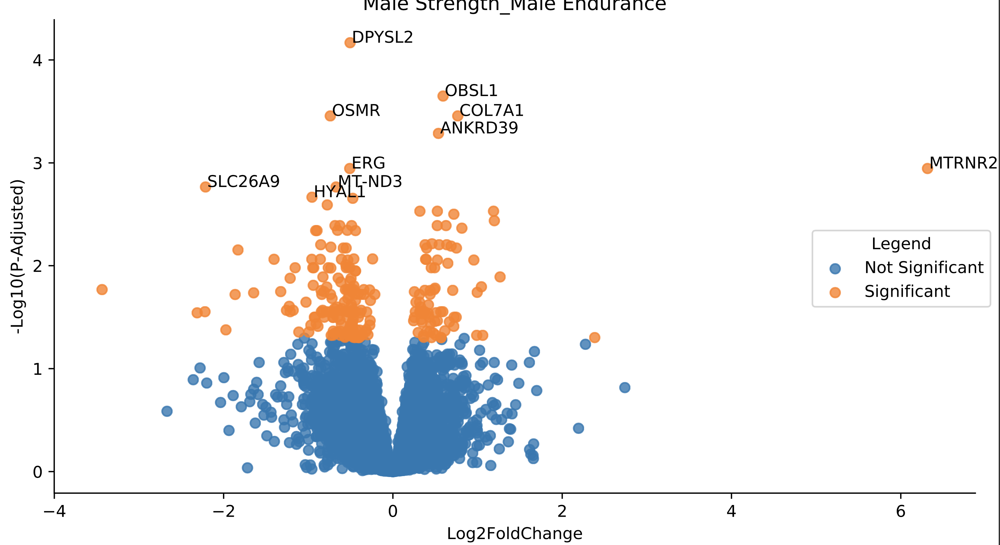
Volcano Plot

Slide 19
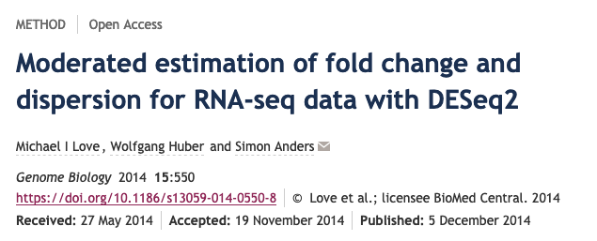
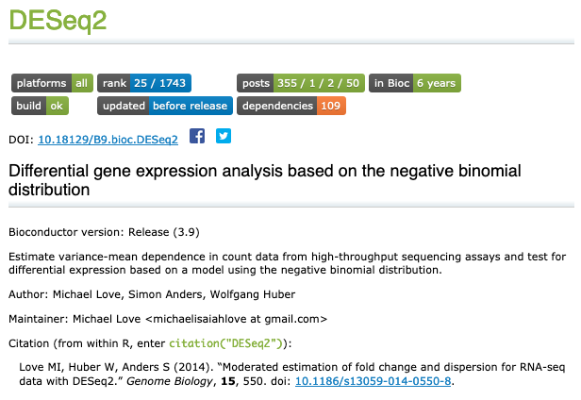
Differential Expression Analysis (3)
DESeq2 is one alternative tool
R-based, easy to use
Features:
Discarding highly noisy variable
FDR
Internal normalization
Sample correction based on variable
Complex contrast

Slide 20
Functional Analysis (1)
Differential Expression Analysis give us the gene-level statistics
To understand more on the effect of the changes, further analysis is needed
Gene-Set Enrichment Analysis
KEGG
Gene Ontology
WikiPathway
etc
Notes:
Reporter

Slide 21
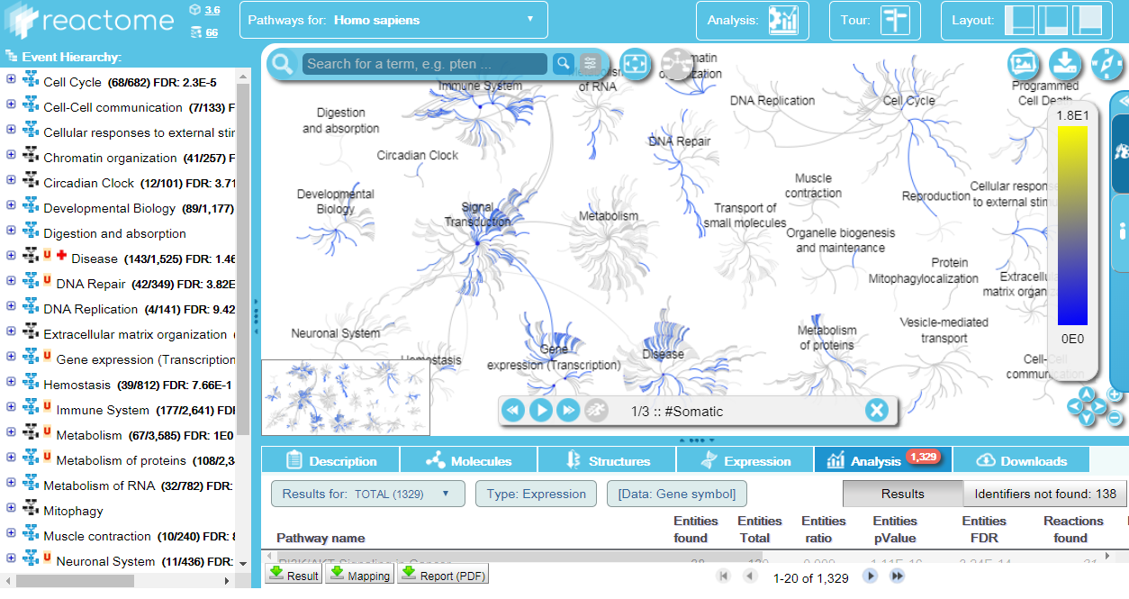
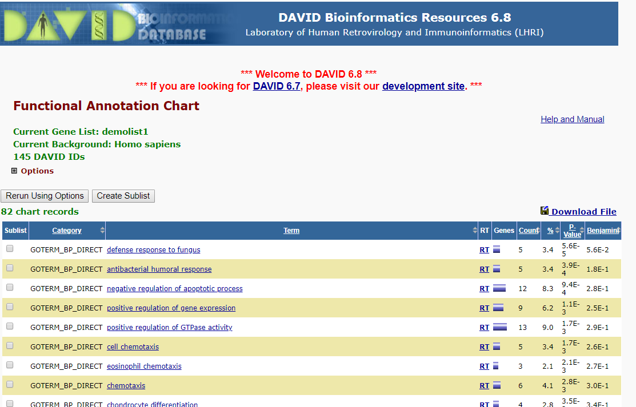
Functional Analysis (2)
Popular Tools:
Reactome
Enrichr
David
KEGG
Piano → Our fave!!
Notes:
Reporter

Slide 22
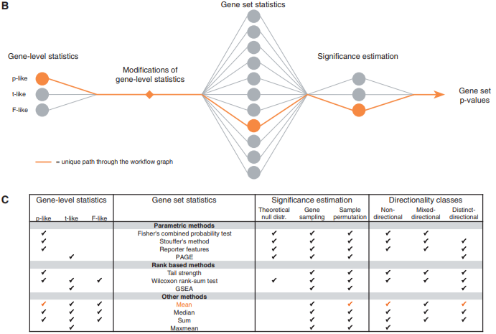
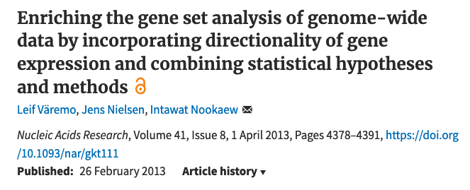
Functional Analysis (3)
PIANO is R-Based GSEA tool
Compatible with DESeq2 output
Require gene-set collection
Advantages:
Flexible
Considering the small gene changes as “concert”
Notes:
Reporter

Slide 23
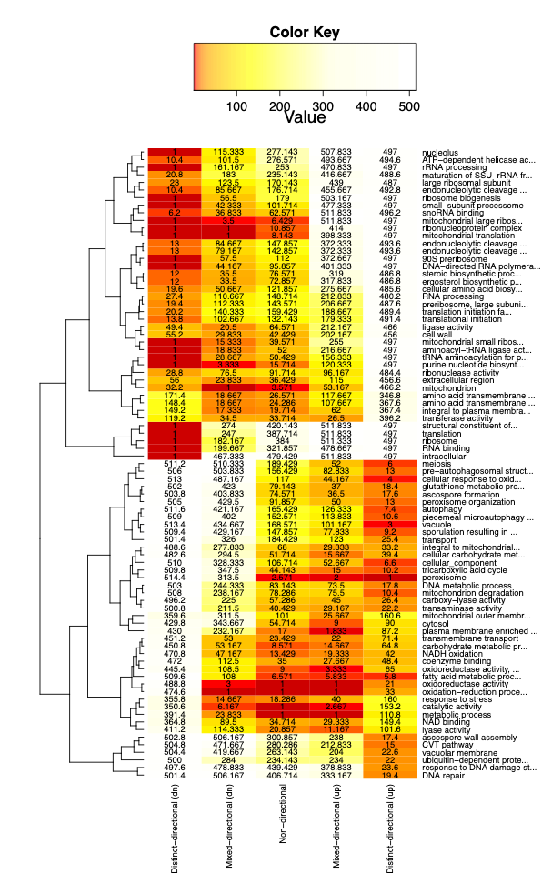
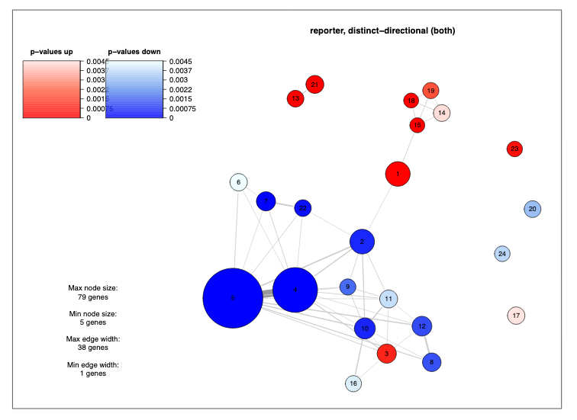
Functional Analysis (4)
Network-like representation
Heatmap

Slide 24
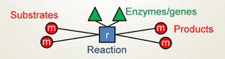
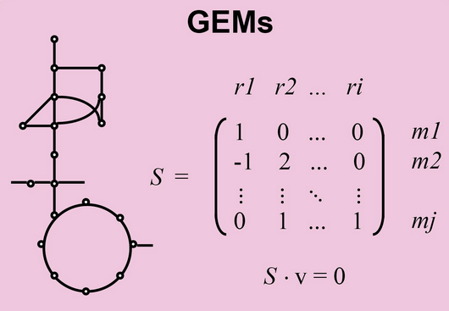
GEM
Mathematical reconstruction of metabolic network
Representation of:
Tissues
Cells
Whole Body
Consisting of gene, protein and metabolic reaction (and its relationship)
Mass-balanced
Notes:
GEM

Slide 25
GEM (2)
Flux-balanced analysis
pFBA
FVA
Essentiality Analysis
Reporter Metabolites
Reporter Subnetwork
etc

Slide 26
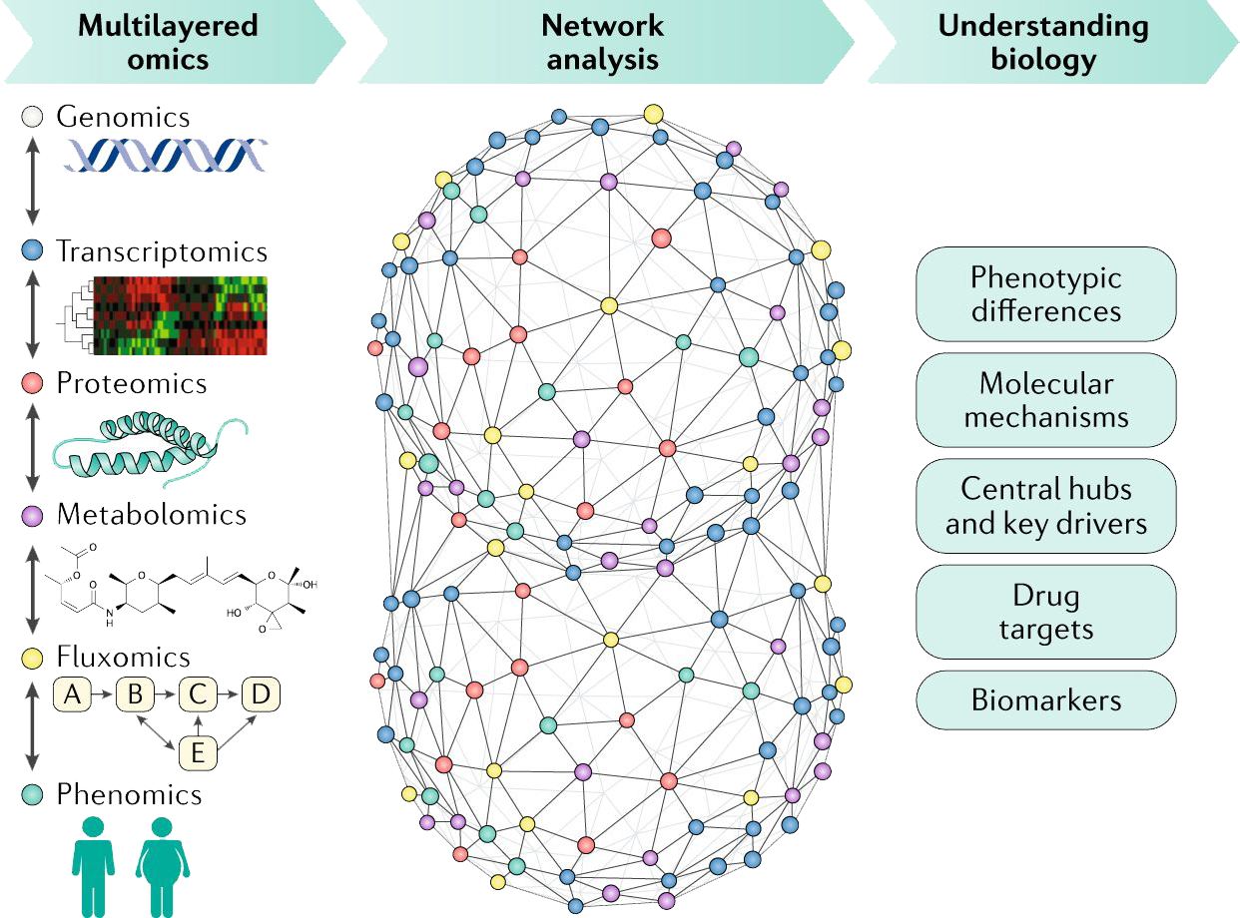
Network Analysis (1)
Understanding the characteristic of:
Tissues
Cells
Other Molecular Comps.
Understanding cross-talk and biological functions
Explaining the behavioral changes due to varying conditions
https://doi.org/10.1038/s41575-018-0007-8

Slide 27
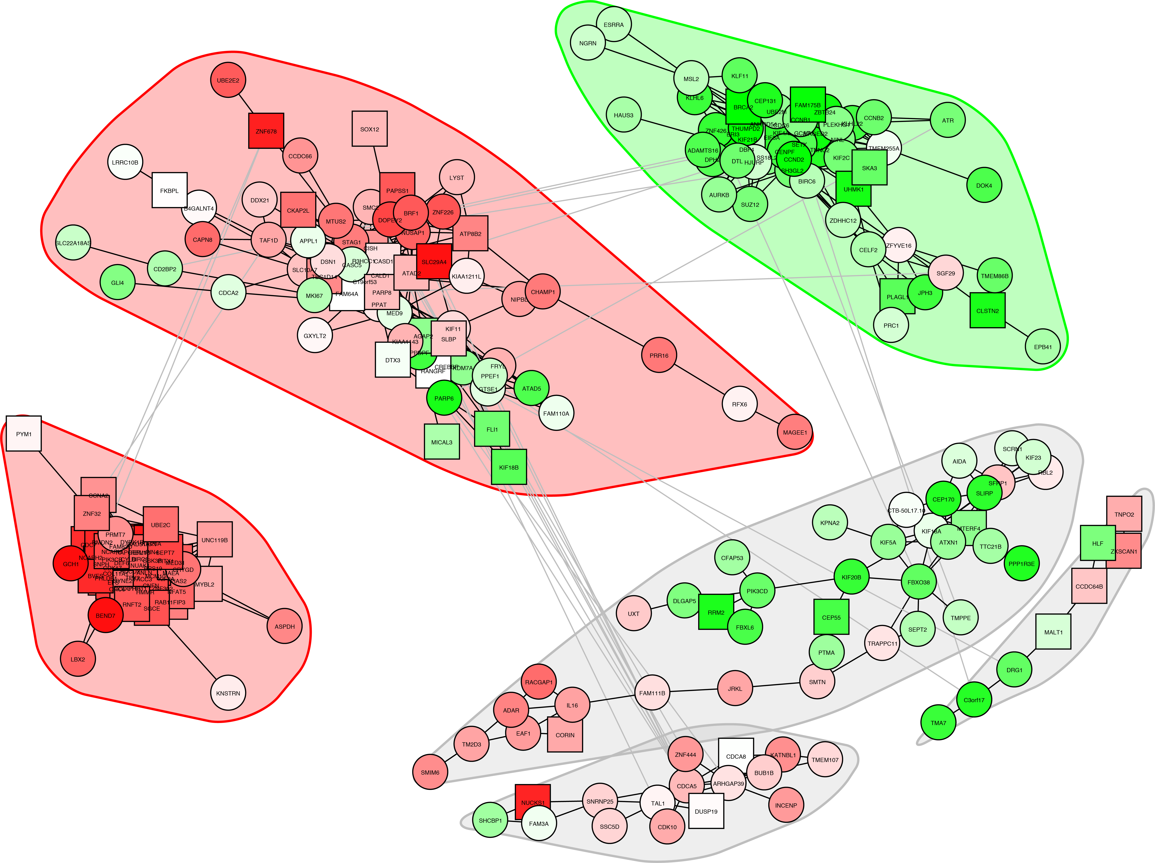
Network Analysis (2)
Genome-Scale Metabolic Models (GEM)
Transcriptional Regulatory Network (TRN)
Protein-Protein Interaction Network (PPIN)
Signaling Network
Co-expression Network
Integrated Network
Biochemical Network

Slide 28
Network Analysis (3)
Co-Expression Network
Gene-Gene Interaction
Correlation between genes
No causality inferred
Transc. Regulatory Network
Gene-Gene Interaction
Gene and its regulator
Causality inferred
PPIN
Protein-Protein Interaction
Physical contacts between proteins
Direct relationship
Integrated Network
Gene-Gene Interaction
Based on PPI, TRN, Coexp, GEM
Co-regulation between genes

Slide 29
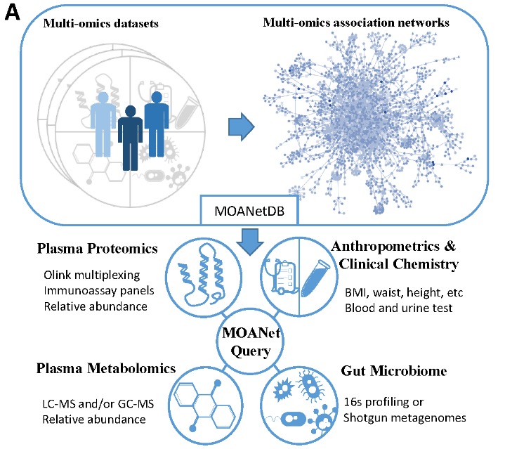
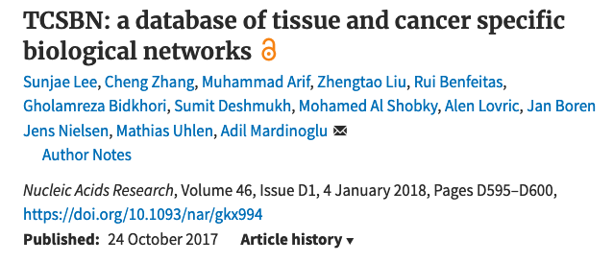
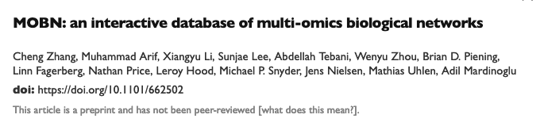
Network Analysis (4)
Target Discovery
Multi-omics Integration
Centrality Analysis:
Betweenness
Degree
Centrality
Community Analysis
Walktrap
Leiden/Louvain
Enrichment Analysis
http://multiomics.inetmodels.com
http://inetmodels.com

Slide 30
Summary
Wet-lab Experiments
Quality Control
Genome Mapping
Quantification
RNA Extraction
Library Preparation
Sample Exploration
Differential Expression
Sequencing
Functional Analysis
GEM
Network Analysis
Data Processing
KEGG
GO
FBA
Reporter
Metabolites
Coexp
IN
TRN
Data Analysis

Slide 31


